Slide 1
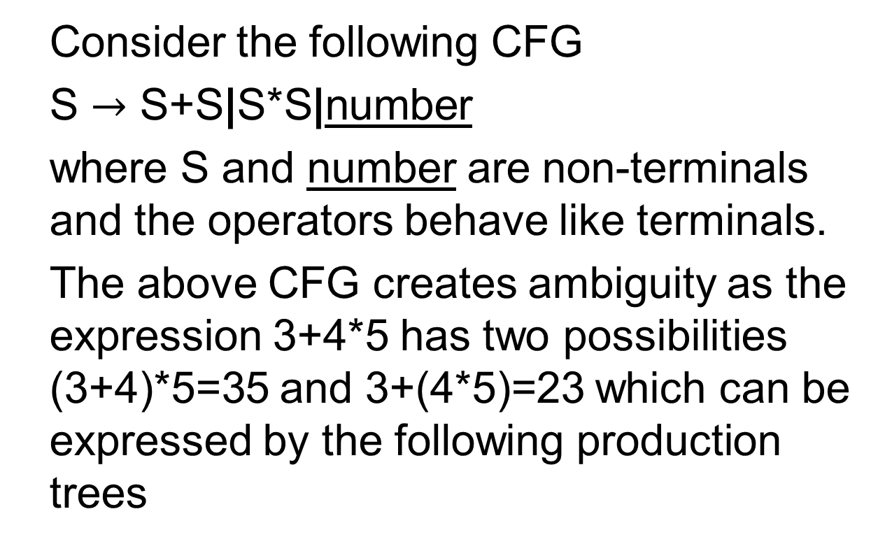
Example
Consider the following CFG
S $→$ S+S|S*S|number
where S and number are non-terminals and the operators behave like terminals.
The above CFG creates ambiguity as the expression 3+4*5 has two possibilities (3+4)*5=35 and 3+(4*5)=23 which can be expressed by the following production trees

Slide 2
Example continued …
S
S
S
S
(i)
+
(ii)
S
S
*
3
S
S
S
S
*
+
5
4
5
3
4

Slide 3

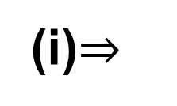
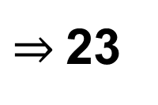
Example continued …
The expressions can be calculated starting from bottom to the top, replacing each nonterminal by the result of calculation e.g.
S
S
S
$$⇒$$
$⇒$23
3
3
(i)$⇒$
+
+
20
4
5
*

Slide 4

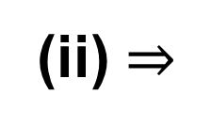
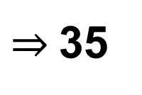
Example continued …
Similarly
The ambiguity that has been observed in this example can be removed with a change in the CFG as discussed in the following example
S
S
(ii) $⇒$
S
5
$$⇒$$
7
5
$⇒$35
*
*
3
4
+

Slide 5
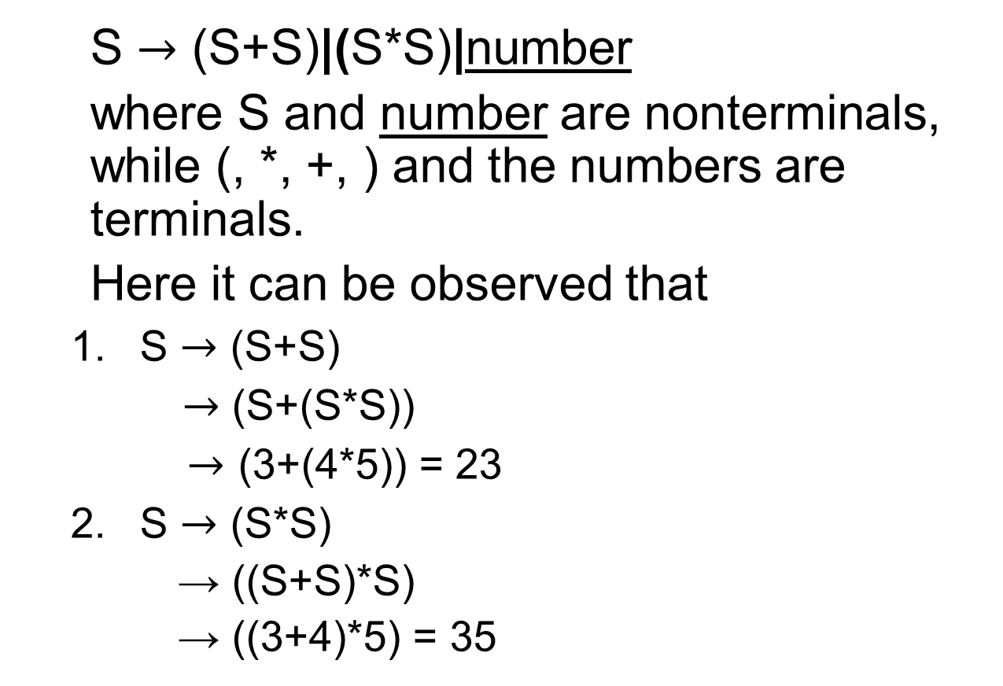
Example
S $→$ (S+S)|(S*S)|number
where S and number are nonterminals, while (, *, +, ) and the numbers are terminals.
Here it can be observed that
S $→$ (S+S)
$→$ (S+(S*S))
$→$ (3+(4*5)) = 23
S $→$ (S*S)
→ ((S+S)*S)
→ ((3+4)*5) = 35

Slide 6
Polish Notation (o-o-o)
There is another notation for arithmetic expressions for the CFG S→S+S|S*S|number. Consider the following derivation trees
S
S
S
S
(i)
+
(ii)
S
S
*
3
S
S
S
S
*
+
5
4
5
3
4

Slide 7
Polish Notation (o-o-o)
The arithmetic expressions shown by the trees (i) and (ii) can be calculated from the following trees, respectively
Here most of the S’s are eliminated.
S
S
+
*
(i)
3
(ii)
+
5
*
3
4
4
5

Slide 8
Polish notation continued …
The branches are connected directly with the operators. Moreover, the operators + and * are no longer terminals as these are to be replaced by numbers (results).
To write the arithmetic expression, it is required to traverse from the left side of S and going onward around the tree. The arithmetic expressions will be as under
(i) + 3 * 4 5 (ii) * +3 4 5
The above notation is called operator prefix notation.

Slide 9
Polish notation continued …
To evaluate the strings of characters, the first substring (from the left) of the form operator-operand-operand (o-o-o) is found and is replaced by its calculation e.g. (i) +3*4 5 = +3 20 = 23
(ii) *+3 4 5 = * 7 5 = 35
It may be noted that 4*5+3 is an infix arithmetic expression, while an arithmetic in (o-o-o) form is a prefix arithmetic expression.
Consider another example as follows

Slide 10
Example
To calculate the arithmetic expression of the following tree
S
*
+
6
*
5
+
+
1
2
4
3

Slide 11
Example continued …
it can be written as
*+*+1 2+3 4 5 6
The above arithmetic expression in (o-o-o) form can be calculated as
*+*+1 2+3 4 5 6 = *+*3+3 4 5 6
= *+*3 7 5 6 = *+21 5 6 = *26 6 = 156.
Following is a note

Slide 12
Note
The previous prefix arithmetic expression can be converted into the following infix arithmetic expression as
*+*+1 2+3 4 5 6
= *+*+1 2 (3+4) 5 6
= *+*(1+2) (3+4) 5 6
= *(((1+2)*(3+4)) + 5) 6
= (((1+2)*(3+4)) + 5)*6

Slide 13
Task
Convert the following infix expressions into the corresponding prefix expressions. Calculate the values of the expressions as well
2*(3+4)*5
((4+5)*6)+4

Slide 14
Ambiguous CFG
The CFG is said to be ambiguous if there exists atleast one word of it’s language that can be generated by the different production trees.
Example: Consider the following CFG
S → aS|Sa|a
The word aaa can be generated by the following three different trees

Slide 15
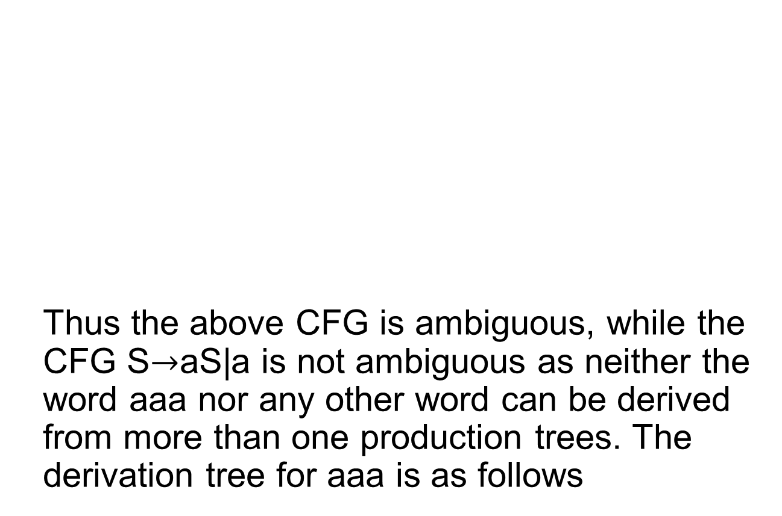
Example continued …
S
S
S
Thus the above CFG is ambiguous, while the CFG S$→$aS|a is not ambiguous as neither the word aaa nor any other word can be derived from more than one production trees. The derivation tree for aaa is as follows
a
S
a
S
S
a
a
S
a
a
S
S
a
a
a

